Slide 1
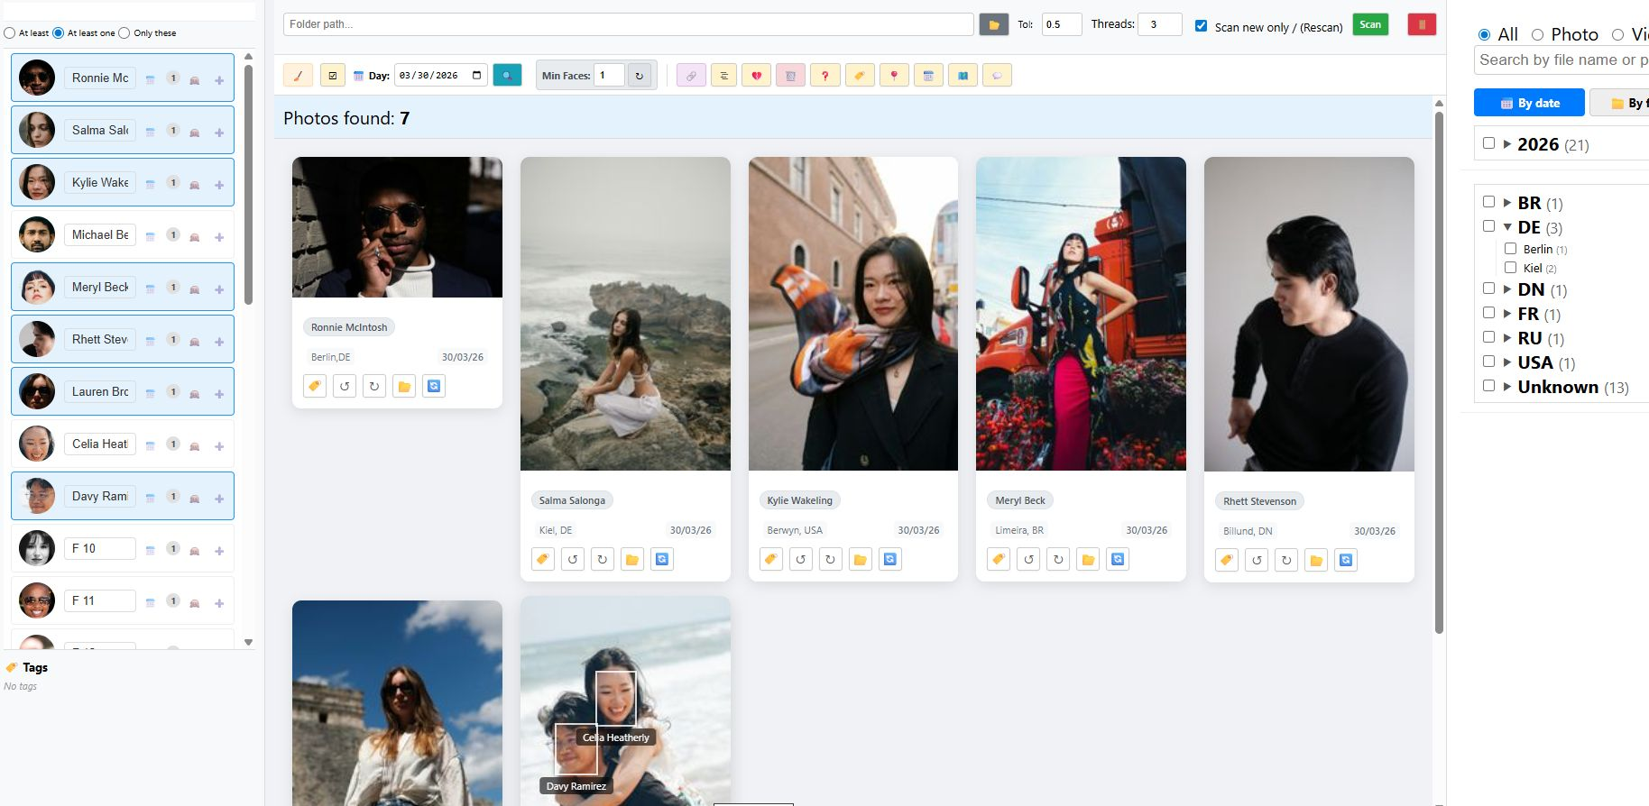
https://www.samtrest.com/PhotoManager/photo_manager.html

Slide 2
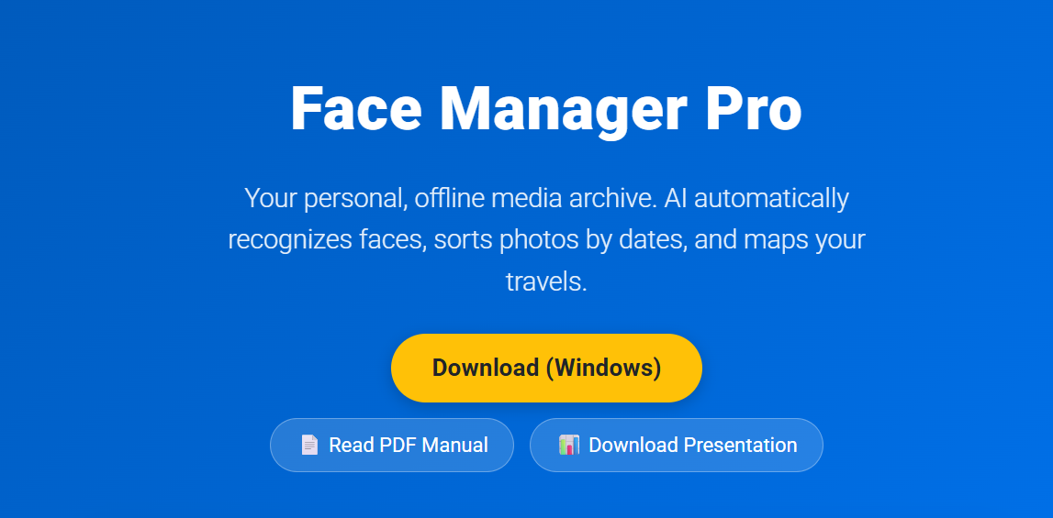
Face Manager Pro — Your Smart Media Archive
• Local photo and video archive management system using artificial intelligence.
• Intuitive interface divided into three workspaces: face panel on the left, gallery in the center, and deep filtering system on the right.
• Support for both photos and video files.
The app doesn't require any additional software installation. Just download the file, unzip it, and you can use it without an internet connection.

Slide 3
Intelligent AI Scanner
• Tolerance (Tol): Adjustable neural network sensitivity threshold (from 0.1 to 1.0) to adapt to different photo qualities.
• Multithreading (Threads): Parallel file processing in multiple threads for maximum speed.
• Smart resume: 'Scan new only' checkbox allows instantly skipping already indexed files, saving time.

Slide 4
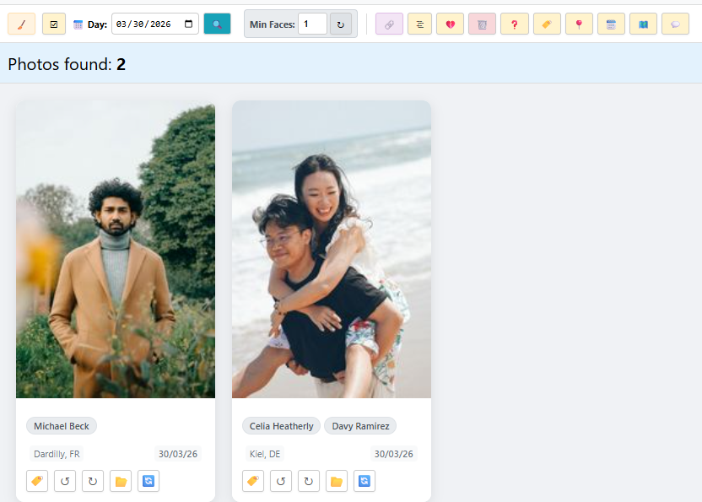
Face Recognition and Management
• Automatic grouping of found faces with a photo count.
• Search logic: Find people in group photos using 'At least', 'At least one', or 'Only these' modes.
• Quick actions: View growth timeline, hide to archive, or manual assignment.
• Global tags: Quick access to custom labels.

Slide 5
Deep Filtering and Navigation
• Content type and Text: Switch between Photo/Video and text search by file name.
• Date hierarchy: Convenient 'Year ➔ Month ➔ Day' tree for finding events.
• Folder filter: System displays clean, trimmed directory names for easy navigation.
• Geolocation: Automatic distribution of photos by countries and cities based on EXIF GPS data.

Slide 6
Batch Operations
• Merge and Detach: Combine multiple faces into one or detach incorrect recognitions.
• Data editing: Mass assignment of tags, geolocations, changing dates, and adding comments.
• Export: Physical copying of selected shots to a separate folder.
• Anomaly search: Find unidentified photos using the 'Min Faces' filter.

Slide 7
Detailed Photo Work
• AI Visualization: Rectangles with names over recognized faces on preview.
• Lossless rotation: Rotation buttons physically rotate the file and mathematically recalculate face coordinates.
• Targeted rescan: Ability to rescan a photo with a lowered threshold if the face is in shadow.
• Quick access to the original file in Explorer.

Slide 8
Interactive Geo-Map
• Travel visualization: All indexed photos with GPS coordinates are automatically mapped on the world map.
• Interactive markers: Clicking on a point shows the number of shots and immediately applies a filter to view them.

Slide 9
Administration and Data Integrity
• Console scanner: Support for background scan launch via CMD without loading the graphical interface.
• Checker module: Built-in audit utility that compares physical files on disk with records in the SQLite database.

