Slide 1
Oracle Dependencies Analyzer
ODA
Over time, in large companies we see many Legacy systems that work with several Databases, this difficulty makes it almost impossible to get answers regarding connections between DB objects, programs, Boards, reports, etc..
Lack of technical documentation for system or partial documentation, incompatibility between systems and complexity, are just some of the reasons it is impossible to determine the source of influence on the objects.
Application can include several hundred * ORACLE * FORMS and REPORTS that is using several thousand objects inside ORACLE (This is on Tables, Views, Packages, Synonyms, DB Links)
Legacy systems have long lost any structures which general logic can understand or analyze the objects can be identified. Something similar can be seen in INTERNET, maximum you can see the logic of a site, but the structure and relationships in INTERNET itself is impossible to know.
http://www.samtrest.com

Slide 2
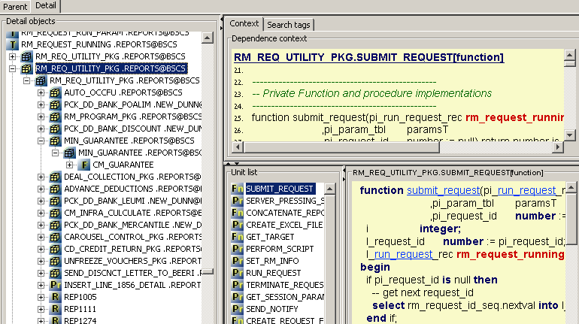
Oracle Dependencies Analyzer
ODA
http://www.samtrest.com

Slide 3
Source of Data
Objects of Oracle database
  Packages, Procedures, Functions,
  Synonyms, Tables
Oracle Forms/Reports
Flat text file
  Unix Scripts, SQL Scripts, C/C++....
Informatica repository
Word file
free world search

Slide 4
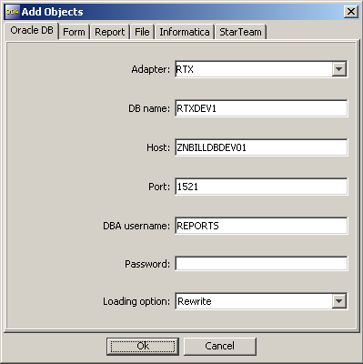
Source of Selecting screen

Slide 5
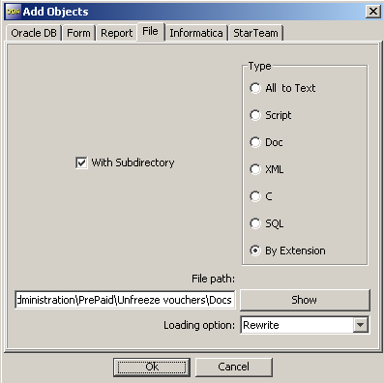
Source of Selecting screen

Slide 6
System Requirement
Java Run Time Version 6 and up
Windows / Unix
java -Xms320m -Xmx1024m –jar oda.jar

Slide 7
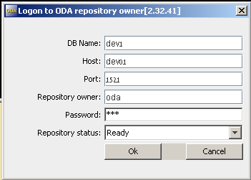
System Requirement
Entrance

Slide 8

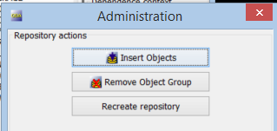
Getting started
Open the administration
window
Press “Insert objects” button
Connect to analyzed database and download objects to the ODA repository

Slide 9
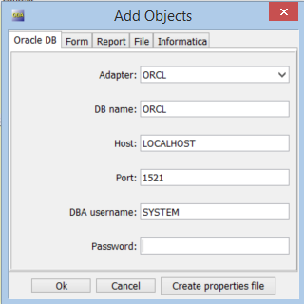
Download database objects
For this downloading you need connect to the database user what see analyzed objects

Slide 10
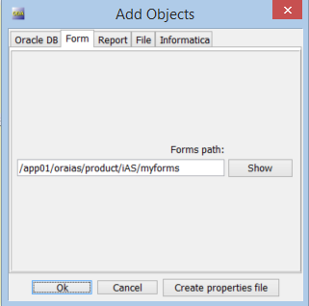
Load Oracle forms
Choose path to the directory or to the form file

Slide 11
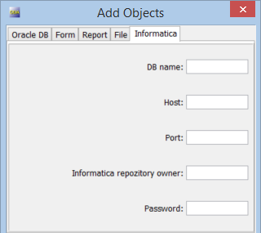
Load INFORMATICA metadata
For this downloading you have to connect to the INFORMATICA repository user

Slide 12
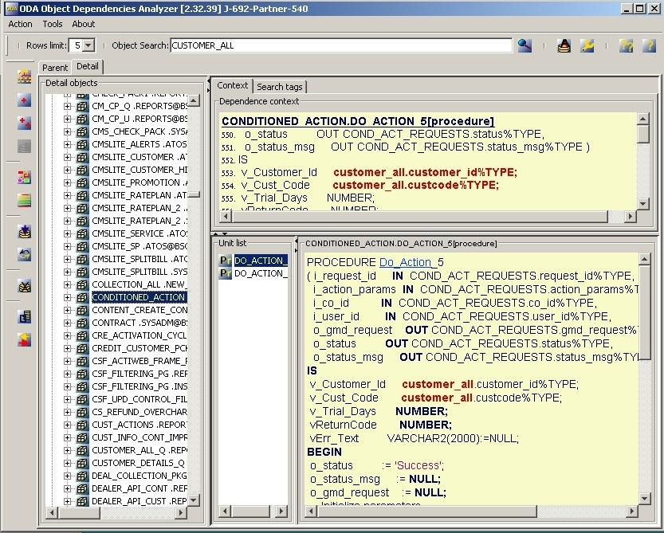
Screen structure

Slide 13
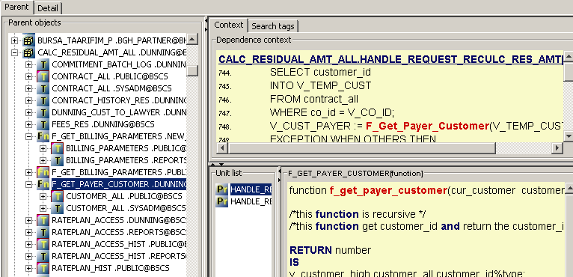
Tree structure
Parent tree

Slide 14
Details
Objects tree

Slide 15
Toolbar vertically
Object dependencies search
Table retrieval
Object browsers
Offline dependencies report
Deleting an object

Slide 16
Toolbar horizontally
Row limits
Objects search

Slide 17
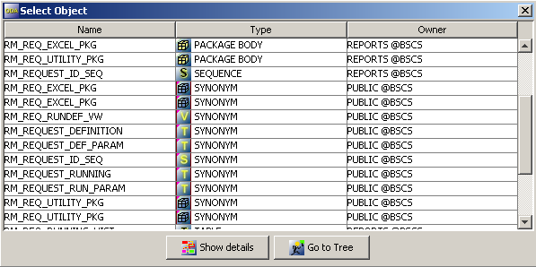
Choose object from the screen

Slide 18
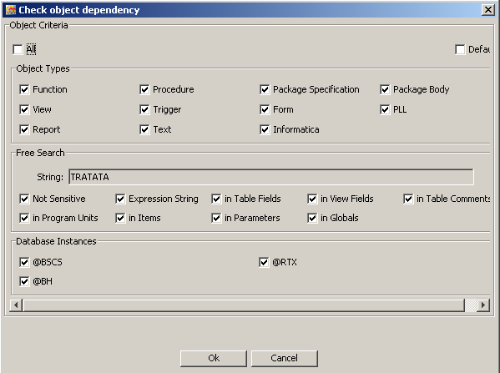
Search Settings screen hanging

Slide 19
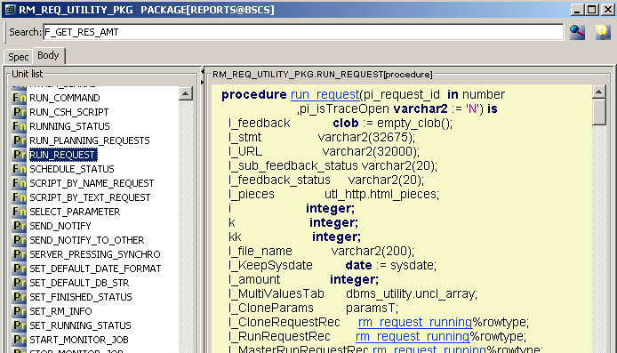
Show Dependencies
PL/SQL

Slide 20
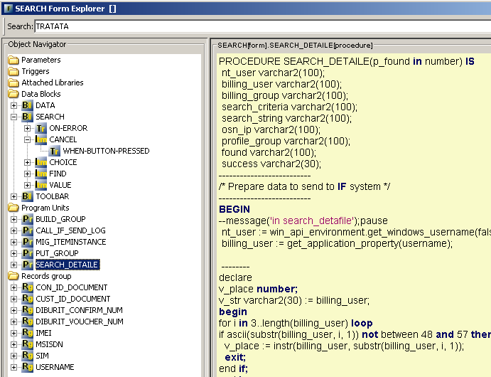
Show Dependencies
FORM/REPORT

Slide 21
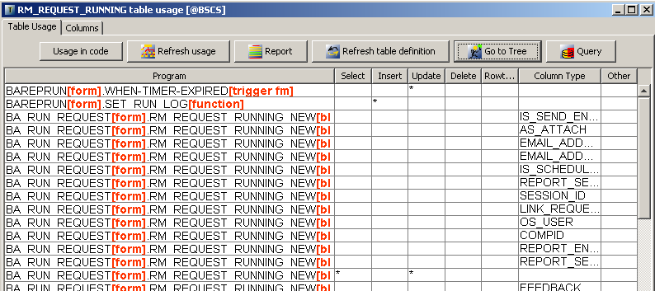
Show Dependencies
Table usage

Slide 22
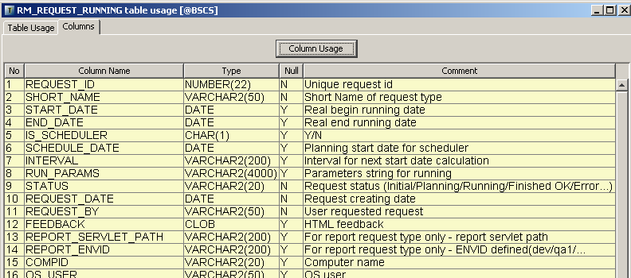
Show Dependencies

Slide 23
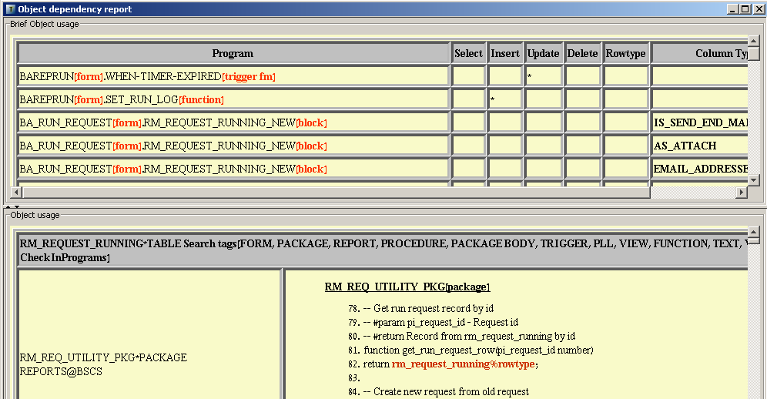
Offline dependencies report

Slide 24
More Options
Search in Code
(Double click on the word code)
Copy dependency to EXCEL
Change the context framework
Get table column dependencies
Extracting data from a table
Smart search package procedures

Slide 25

Thank you
ODA
Oracle Dependencies Analyzer
Yuri Slutsky
yuri_slutsky@yahoo.com
www.samtrest.com

